Slide 1
Deals In All Type of Industrial Safety Products
www.buytmindustries.co.in
Email :- info@buytmindustries.co.in
Mobile No:- 9355238340 or 41

Slide 2
Our Regular Products
Disposable Products
Face Mask
Hand Glove
Dangri Coverall Suit
Eye Protection
Ear Protection
Safety Shoes
Fire Protection Equipment
Road Safety Item
Fall Protection Equipment
Other Special Item
Spill Kit
Spark Arrestor
Wheel Chock
ESD Item (Anti-Static)

Slide 3
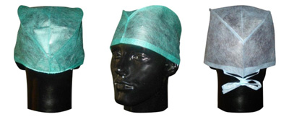
DISPOSABLE CAP
Surgeons Caps
Bouffant Caps

Slide 4
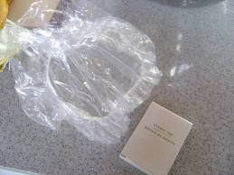
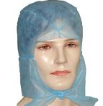
DISPOSABLE CAP
Shower Caps Transparent clear
Hood Cap

Slide 5
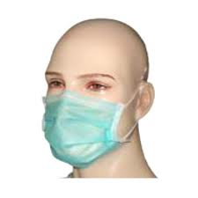
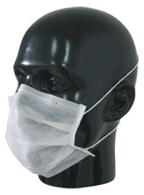
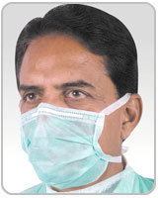
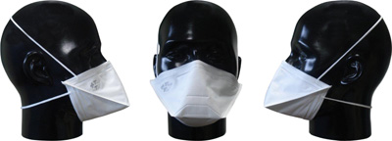
DISPOSABLE MASKS
Head Loop Face Mask
Disposable Face mask
N95 Particulate Respirator Mask
Tie On Mask
Available in 1/2/3/4 ply

Slide 6
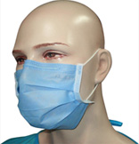
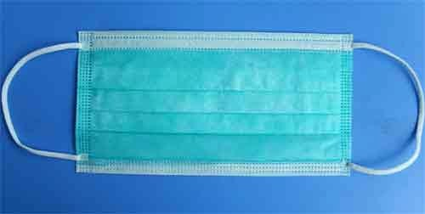
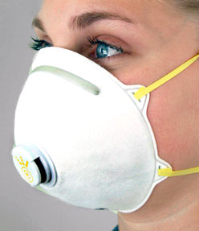
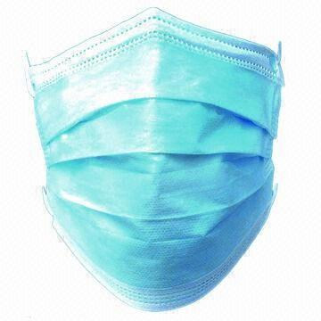
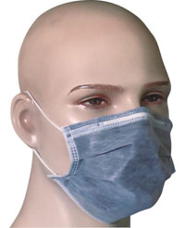
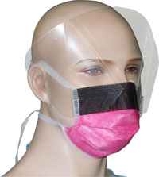
RESPIRATIORY MASKS
2-Ply Elastic Green Face Mask
1-Ply Face Mask
3-Ply Elastic Green Face Mask
3-Ply 95% Filter Face Mask
3-Ply 99% Filter Face Mask
4-PlyActivated Carbon
Face Mask
4-Ply Anti Fog Visor Face Mask

Slide 7
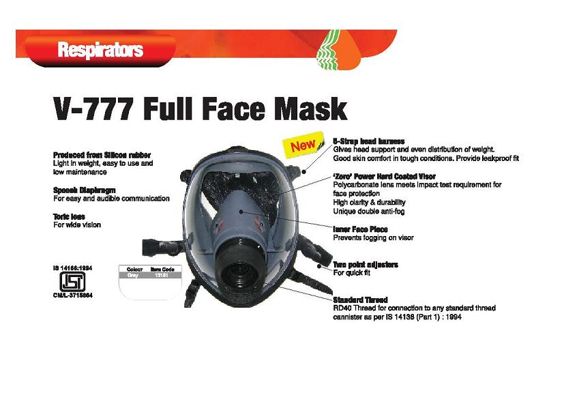
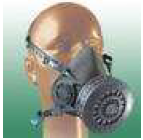
RESPIRATIORY MASKS
Fire Escape Mask
Venus V777 Full Face Mask
3M 6800 Full Face Mask
Venus V-414
Venus V 666 Full Face Mask
Venus V-500 Half Face Mask

Slide 8
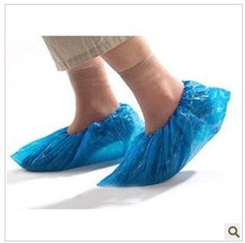
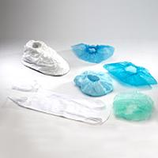
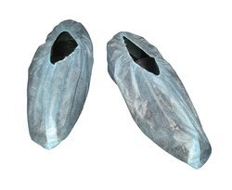
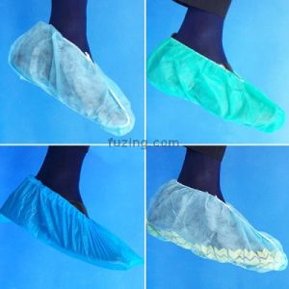
DISPOSABLE SHOE COVER
Machine Shoe Cover
Disposable Shoe Cover
Shoe Cover Non –woven Normal
Shoe Cover Non Woven high ankle
Shoe Cover Stitched
Shoe Cover Non Woven
Shoe Cover Non Stitched

Slide 9
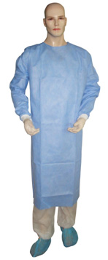
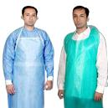
DISPOSABLE APRON
Disposable Apron
Surgeon Apron 50 Gsm Spunbond & Meltblown
Protective Disposable Apron
Disposable Visital Coat

Slide 10
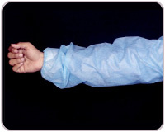
DISPOSABLE ARM SLEEVE
Poly Sleeve
Disposable Arm sleeve
Finger Coat

Slide 11
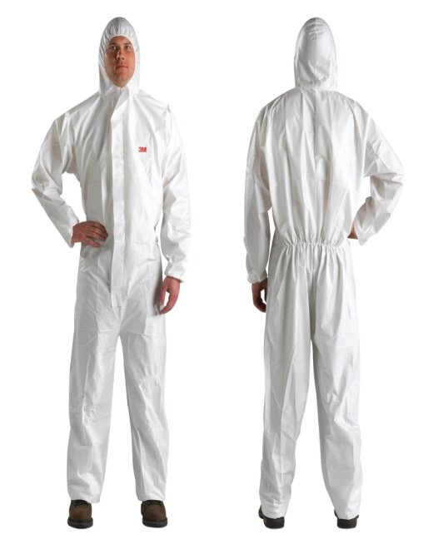
DISPOSABLE COVERALL
Disposable Protective Coverall
Coverall
Body Protective Suit

Slide 12
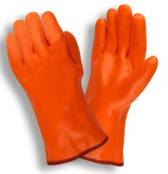
CHEMICAL RANGE OF GLOVES
Nitril Exam Glove
PVC Supported Glove
Heat Resistance Glove
Neoprene Glove

Slide 13
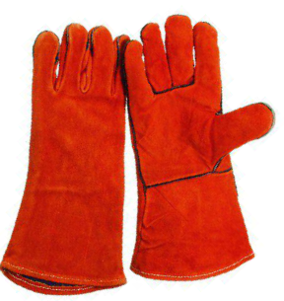
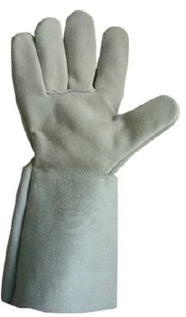
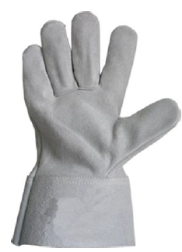
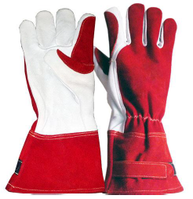
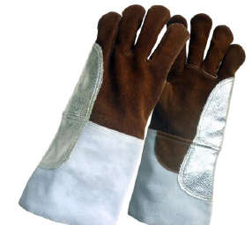
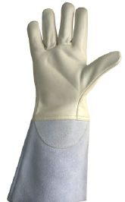
RANGE OF LEATHER GLOVES WELDER GLOVES

Slide 14
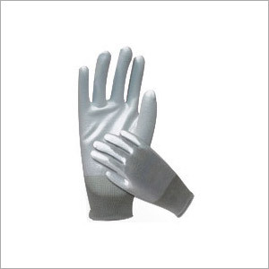
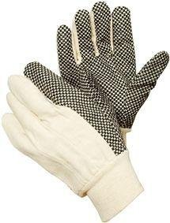
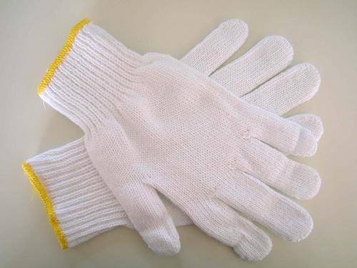
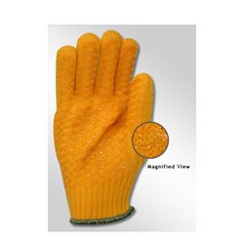
KNITTED RANGE OF GLOVES
Polka Dotted Glove
P U Coated Glove
Drill/Gean/Dotted Glove
Cotton Knitted Glove
Acrylic Knitted Glove
Knitted Heat Resistance Kevlar Glove

Slide 15
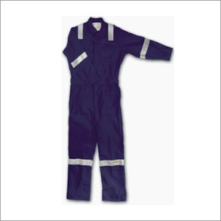
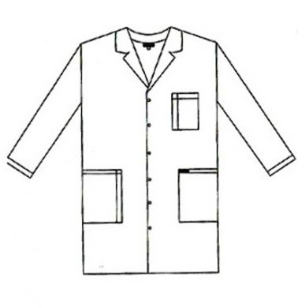
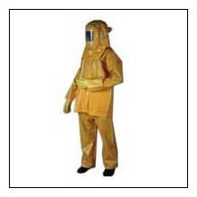
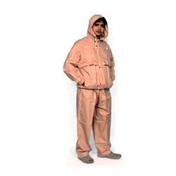
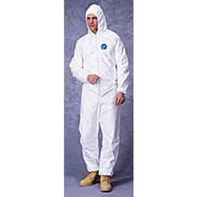
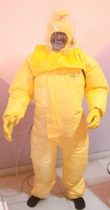
BODY PROTECTION
Dangri
Chemical Suit
Lab Coat
Aluminized Fire Proximity Suit
Welder Apron
Rain Suit Duck Back
Tyvek Chemical Suit
Bamboo Jacket Khaki
Tychem - C

Slide 16
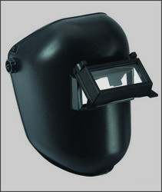
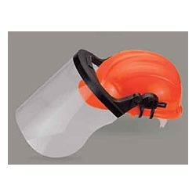
HEAD /FALL PROTECTION
Full Body Harness
Fall Arrester
Industrial Safety Helmet
Welding Shield
Helmet/Shield
Rope Ledder

Slide 17
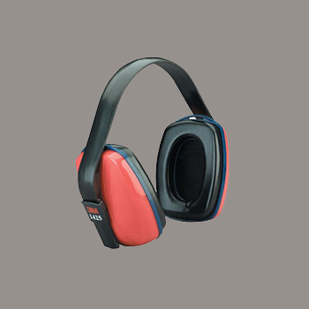
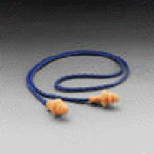
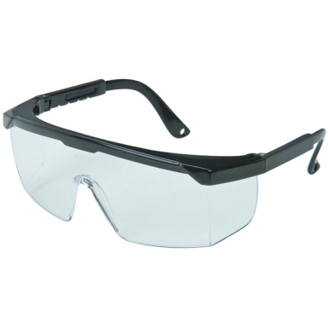
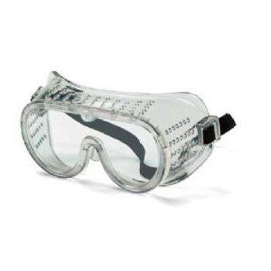
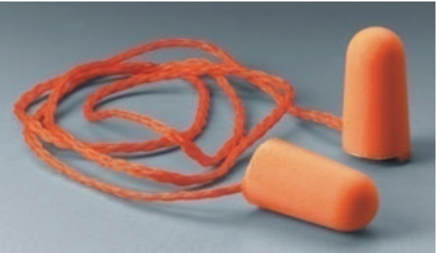
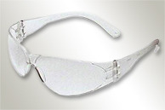
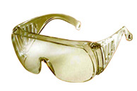
EYE/EAR PROTECTION
Punk Goggle
Chemical Splash
Ear Mask 1425
Ear Plug Re-Usable
Transparent
Gamma Eyewear
Ear Plug 1110

Slide 18
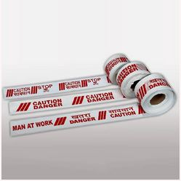
GENERAL SAFETY ITEMS
Hand Metal Detector
Spark Arrester
DFMD
Berricading Tape
Flame Torch
Eye Wash Bottle
Wind Sock
Eye Shower
Life-Buy
First Aid Kit

Slide 19
ROAD SAFETY ITEMS
Delinators
Speed Breaker
Ref-Jacket
Cross-Jacket
Rubber Corner Guard
Solar Delinator
Battan Light
Search Light
Divider Cone
PVC Road Stud
Safety Sign
Convex Mirror
Reflector
Bollard Reflective Strip
Aluminium Stud

Slide 20
FIRE CONTROL ITEMS
Hose Box
Hose Reel
ABC Fire Ex
Fire Bucket With 4 Stand
Hydrant Valve
Fire Blanket
RRL Hose
Fire Bucket

Slide 21
WELDING ACCESSORIES
Spring Post
Welding Hose
Road Lamp
Nylon Rope
Trolly

Slide 22
SAFETY SHOES
RHINE
CONCORD
ALLEN COOPER
ANATULIA SAFETY SHOES
NILE SAFETY SHOES
GANGES

Slide 23
SAFETY SHOES HIGH ANKLE
DUNCUN HIGH
LAHASA CAP SAFETY SHOES
MOMBASA
NILE SAFETY SHOES
FORCE ONE

Slide 24
SPORTS SAFETY SHOES
DUNCUN LOW
BREEZE SPORT
AIR SPORT
LUGANO II
SAHARA SAFETY SHOES

Slide 25
GUMBOOT SHOES
WELLINGTON GUMBOOT
TORPEDO
RUBBER GUMBOOT
LUGANO II
SAHARA SAFETY SHOES

Slide 26
WITHOUT LAYSIS SHOES
AIR
COSAFE META
SAINIX WHITE
PRESIDENT SLIP ON
BREEZE

Slide 27
EAR PROTECTION
BTI-101-CHC
BTI-102-CHC
BTI-103-CHC Visitors
BTI-201-CHC
BTI-202-CHC
BTI-203-CHC
BTI-401-CHC
UVEX SAFETY EYEWEAR
BTI-503-CHC

Slide 28
MEDICAL EYEWEAR RS FULL EYE
BTI-OO1L
BTI-001
BTI-002
BTI-003
BTI-OO4
BTI-006
GAMMA EYEWEAR
BTI-001LW5
BTI-SOO5

Slide 29
REFLECTIVE TAPE

Slide 30
USES OF REFLECTIVE TAPES

Slide 31
Vehicle Marking Tapes

Slide 32
THANKING YOU
Address: Nehru Complex, Near Mother Dairy, Delhi-110091, India
Mobile: +91 9355238340, 9355238341
Website: www.buytmindustries.co.in
Email ID: info@buytmindustries.co.in or sales@buytmindustries.co.in

